Slide 1
Text analysis of Amazon Review Use T10 Earbuds as an Example
Fang Zhu, Yao Du
2021/12/11

Slide 2
Outline
Part 1 Data Analysis
- Data Distribution
- Data Preprocessing
Word Frequency Analysis
Conclusion
Part 2 Text classification with SVM
- Pipeline
- Evaluation Metric
- Result
- Conclusion

Slide 3
Part 1 Data Analysis

Slide 4
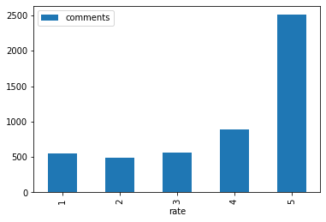
Data Analysis: Distribution
Data: 5507 items of crawled from Amazon Website by Yao Du.
Column 1: Rate, 1 ~ 5
Column 2: Review, text(string)
4 | I’m one of very , very few people who …
https://www.amazon.com/TOZO-Bluetooth-Wireless-Headphones-Waterproof/dp/B07J2Z5DBM/ref=cm_cr_arp_d_bdcrb_top?ie=UTF8&th=1

Slide 5
Data Analysis: Preprocessing
Drop null values
Split & To Lower Case
Strip punctuation
Strip Stopwords

Slide 6
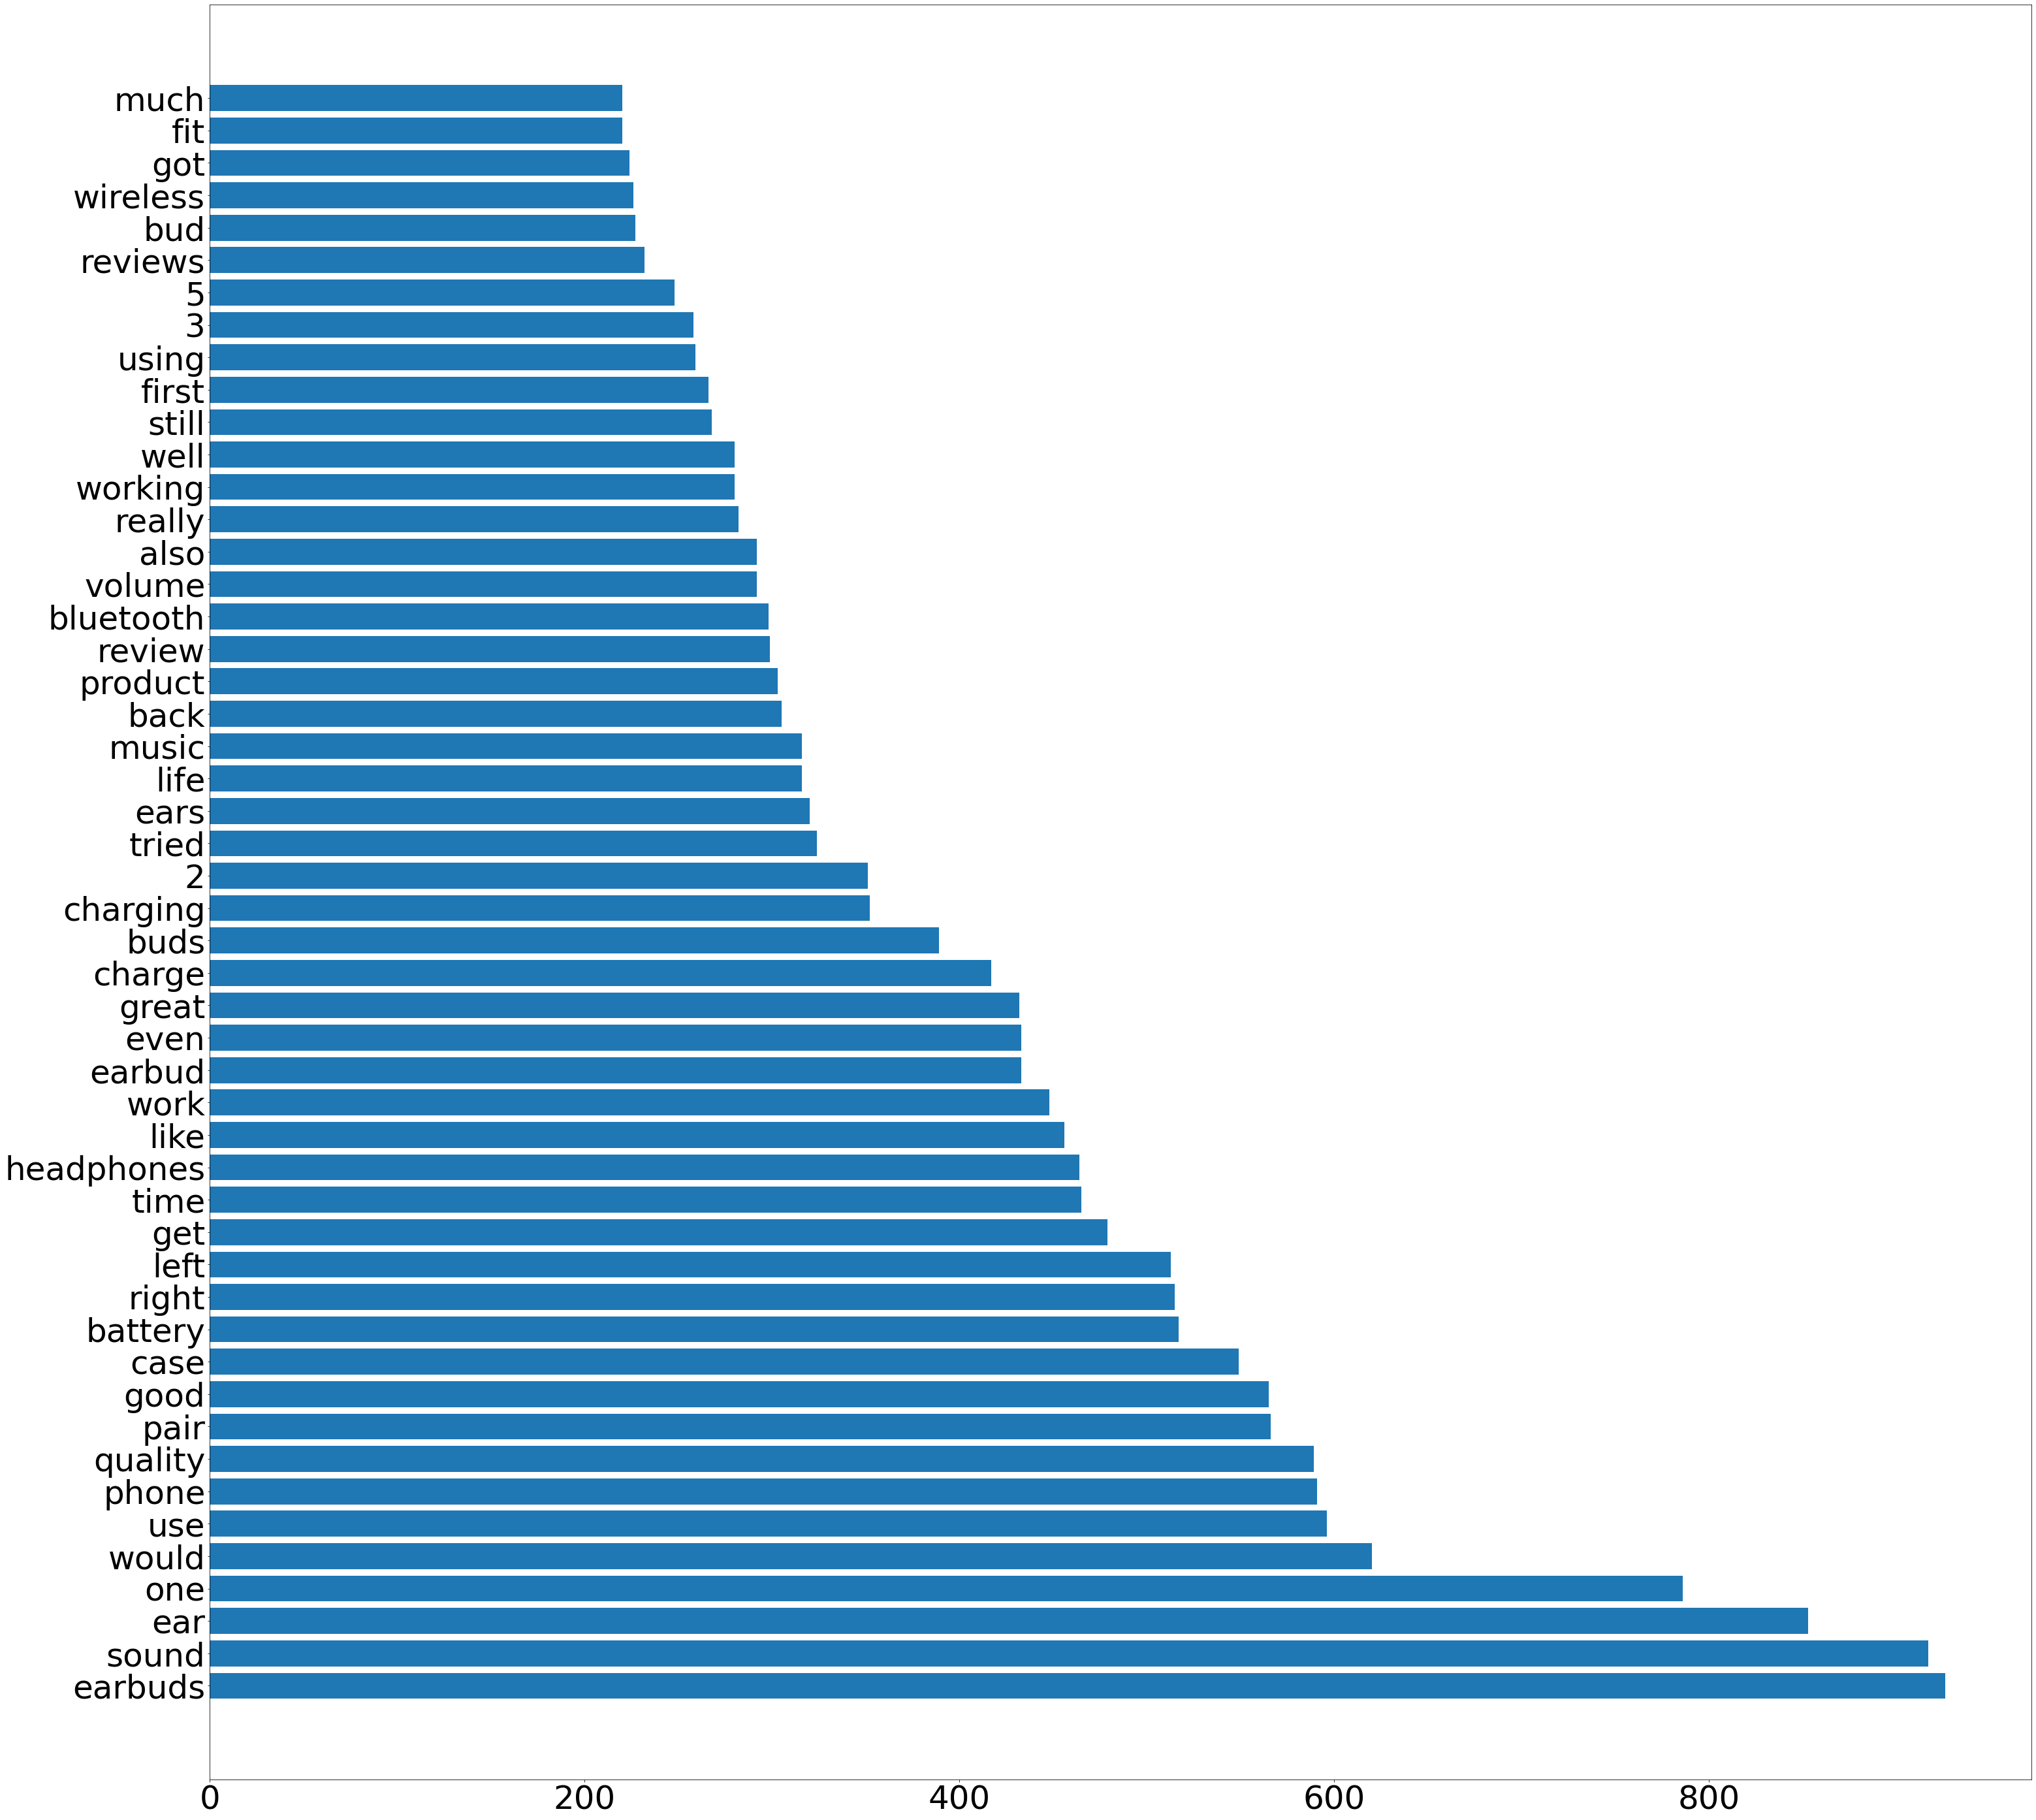
Word Frequency Analysis of Bad reviews
Bad reviews: reviews whose rate < 3 ( 1, 2)
Top 50 words sorted by word-frequency

Slide 7
Word Frequency Analysis of Bad reviews
Conclusion:
volume, sound
Control the sensitivity of volume adjustment
ear
Improve wearing comfort
charge, battery, minute
Improve the battery quality
bluetooth, wireless, connect
Improve the bluetooth stability

Slide 8
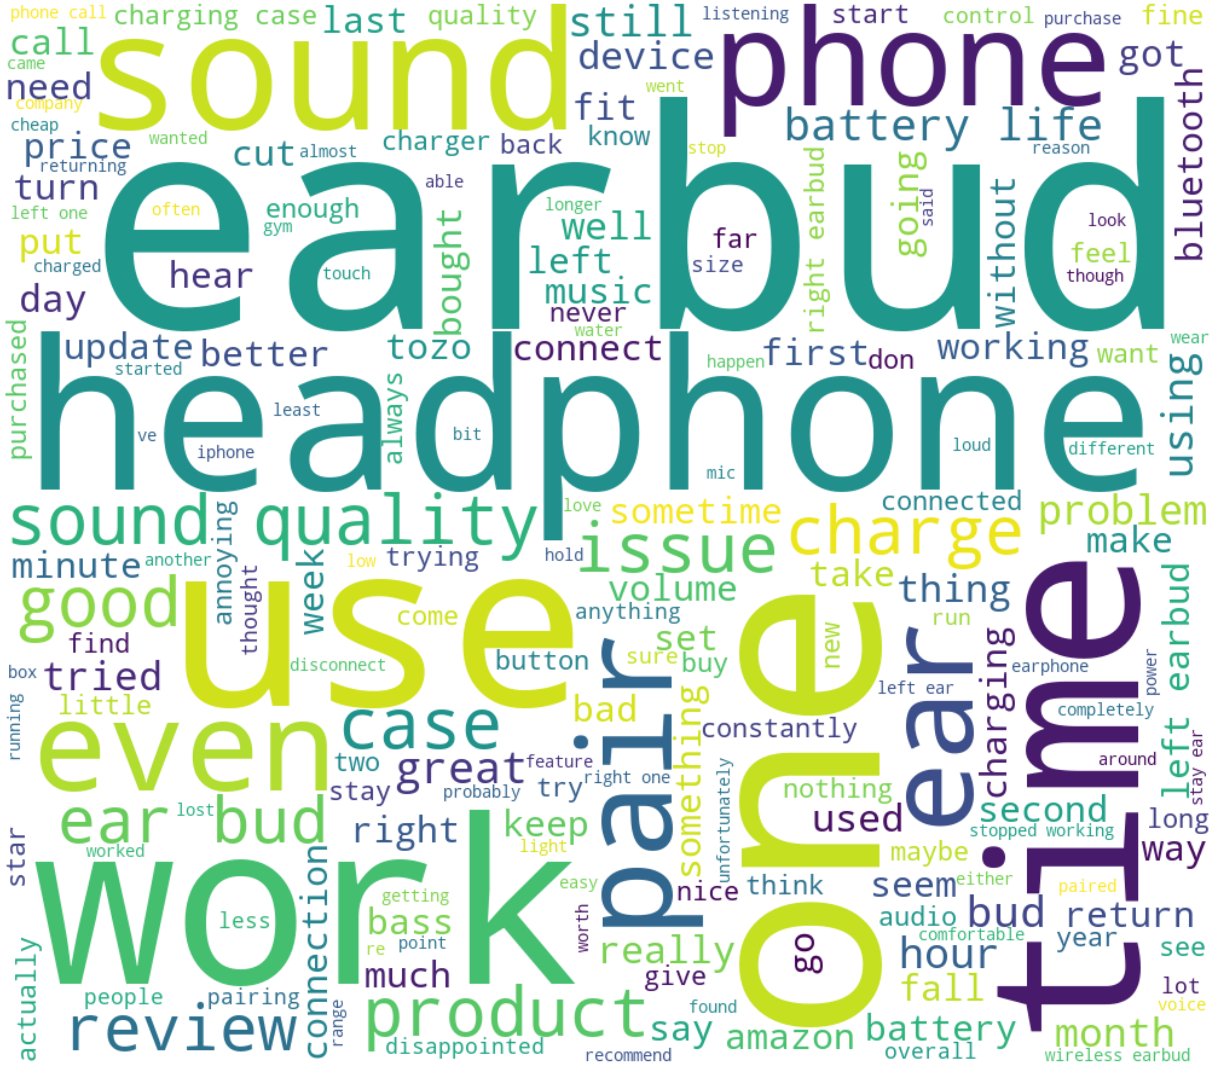
Word Frequency Analysis of Bad reviews

Slide 9
Part 2 Text classification with SVM

Slide 10
Pipeline
Problem Simplication
Vectorization
Hyper-Parameter Adjusting
Evaluation
0(<3)
1(>=3)
TF-IDF
GridSearchCV

Slide 11
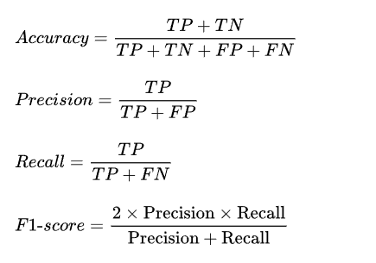
Evaluation Metric
Prediction
 | Positive | Negative
Positive | TP | FN
Negative | FP | TN
Actual

Slide 12
Result
 | Precision | Recall | F1 - Score
0(rate < 3) | 0.68 | 0.45 | 0.54
1(rate >=3) | 0.87 | 0.94 | 0.90
Accuracy = 0.84

Slide 13
Conclusion
Although the overall classification accuracy rate is 0.84, the ability of this classifier to identify bad reviews is far worse than that of good reviews. It may be caused by the following reasons:
Unbalanced data distribution.
2. Insufficient feature extraction of the text.
Based on this, we can make the following improvements in the future:
Crawl more data to alleviate the problem of insufficient samples in certain categories.
2. Weight the loss of samples of different categories to reduce the bias of the classifier
3. Use pre-trained word vectors(Word2Vec, Glove, FASText) for feature extraction so that text information can be extracted more fully.

Slide 14
Reference
Scikit-learn: Machine Learning in Python, Pedregosa et al., JMLR 12, pp. 2825-2830, 2011.

Slide 15
Q & A

